Slide 1
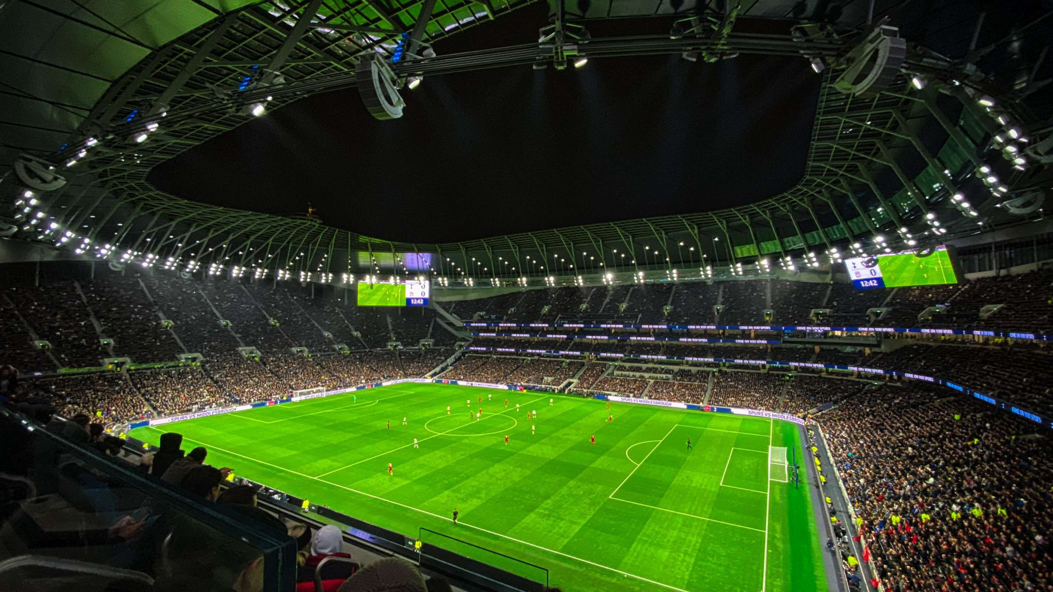

TRANSFERIQ: DYNAMIC PLAYER TRANSFER VALUE PREDICTION USING AI AND MULTI-sOURCE DATA
Presenting you my project that I have been working during The Infosys Springboard Virtual Internship 6.0, for the past eight weeks.
Name: Dharun Kumar S

Slide 2

PROJECT OVERVIEW
The project aims to predict football player market values using AI-based forecasting.
It combines multiple factors like player performance, public sentiment, injury records, and market data.
The idea is to make player valuation data-driven instead of depending only on human opinion or hype.

Slide 3
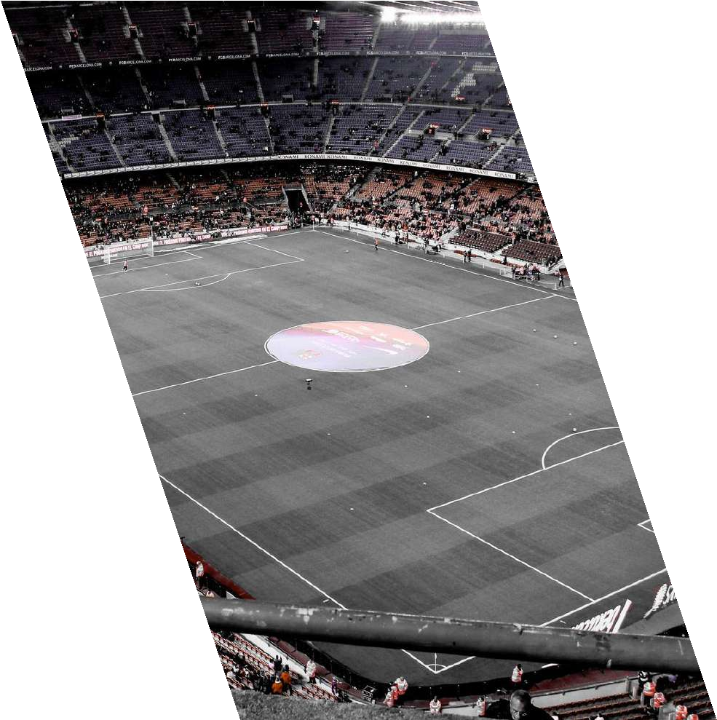
DATASET
The main dataset was taken from Kaggle: https://www.kaggle.com/datasets/sanjitva/predicting- soccer-player-transfer-values
It includes:
  Player age, potential, overall rating, and position
  Club, league, and nationality information
  Historical transfer market values
Additional Data Used:
  Twitter sentiment data: For public perception
  Injury data: Collected from Transfermarkt, which maintains detailed records of player injuries, recovery periods, and match absences

Slide 4
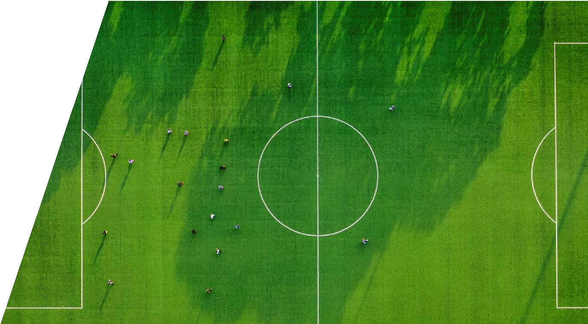
I have performed preprocessing using Python (Pandas, NumPy, and Scikit-learn).
Steps involved:
  I have Removed duplicates and handled missing values using pandas.DataFrame.dropna() and fillna().
  I have scaled numerical attributes with MinMaxScaler and label-encoded categorical features with LabelEncoder.
DATA PREPROCESS

Slide 5
SENTIMENT ANALYSIS
I have collected player mentions from Twitter API (Tweepy library) using hashtags and player names.
I have cleaned text data using Regex and NLTK stopword removal.
I have applied VADER Sentiment Analyzer (from nltk.sentiment.vader) to calculate sentiment polarity scores.
I have computed an average sentiment score per player and merged it into the main dataset.
I have observed that players with higher positive sentiment often had higher predicted market values.
Here, I used Python’s NLTK and Tweepy to connect player popularity from social media with actual market valuation.

Slide 6



MODEL DEVELOPMENT
I used TensorFlow (Keras API) for building the LSTM model.
Then, I used XGBoost library for gradient boosting and ensemble learning.
I have trained two models:
LSTM: Captured long-term dependencies and performance trends from time-series data.
XGBoost: Captured non-linear relationships between player features and market value.
Finally, I combined the outputs using a weighted ensemble approach to improve accuracy.

Slide 7
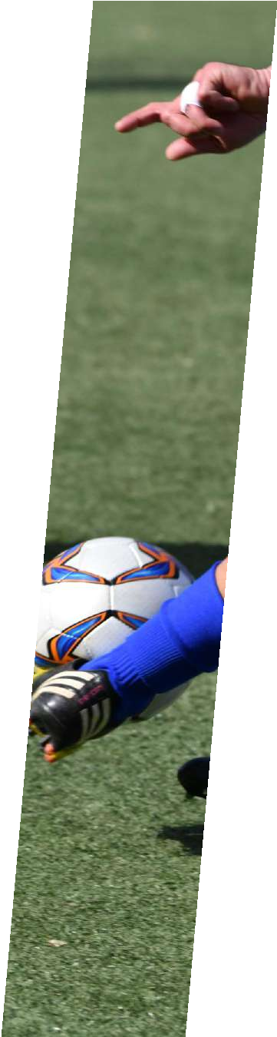
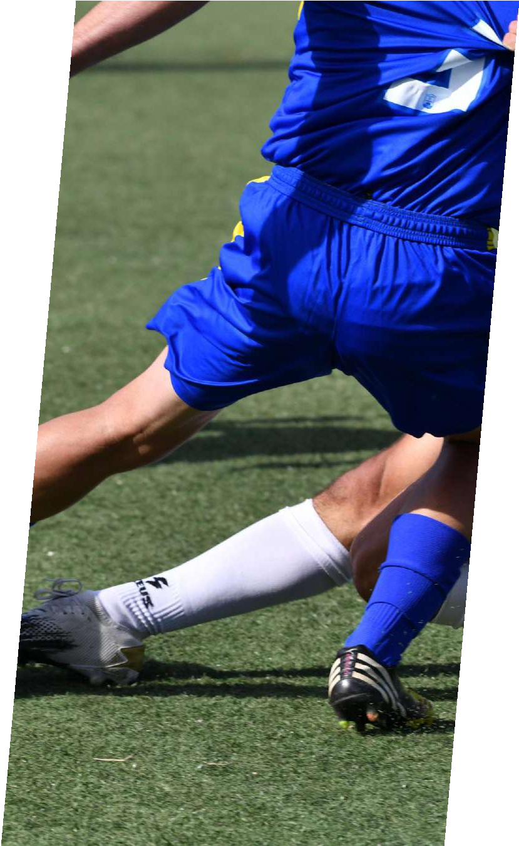

FORECASTING AND EVALUATION
Implemented:
Univariate LSTM: Based only on historical player values.
Multivariate LSTM: I have included injury score, sentiment score, and performance stats.
Used Adam optimizer and Mean Squared Error (MSE) as loss function.
Evaluated models using:
RMSE (Root Mean Square Error)
MAE (Mean Absolute Error)
R² Score
LSTM models visualized and compared using Matplotlib and Seaborn for loss and accuracy plots.

Slide 8
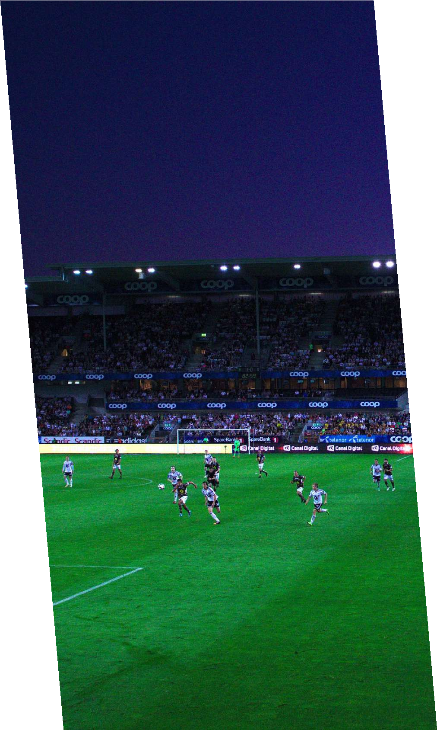


VISUALIZATION AND KEY INSIGHTS
I used Matplotlib and Seaborn to visualize:
Player transfer value trends
Correlation between sentiment, injury, and value fluctuations
Feature importance rankings (through
XGBoost’s feature_importances_)

Slide 9
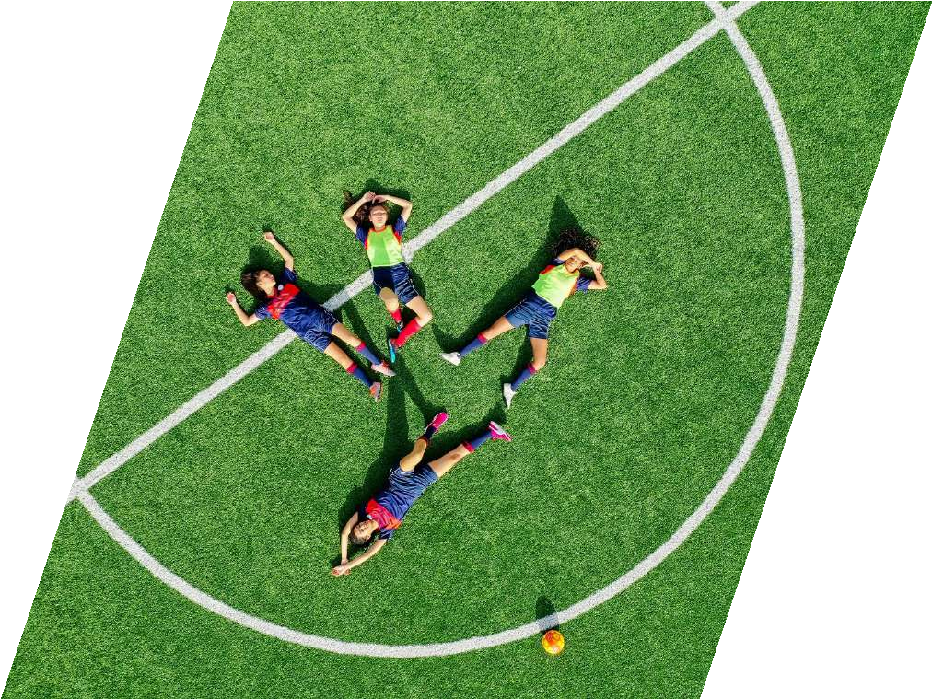

CHALLENGES AND LEARNINGS
Data Synchronization: Aligning time-based Kaggle, Twitter, and Transfermarkt data required date-indexed merging.
Sentiment Cleaning: Tweets contained slang, emojis, and multilingual data, cleaned using Regex and TextBlob translation.
Learned:
Data cleaning and merging with Pandas
Time-series forecasting using TensorFlow (LSTM)
Sentiment scoring using VADER in NLTK
Ensemble modeling using XGBoost and Scikit-learn pipelines

Slide 10

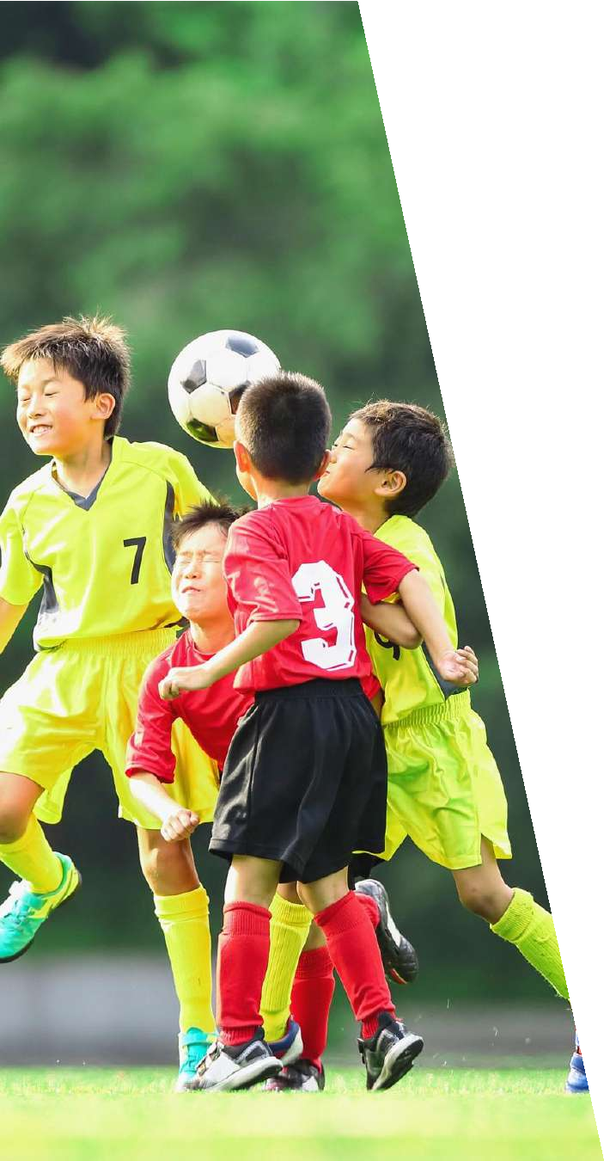
CONCLUSION AND FUTURE SCOPE
I have successfully built an AI-driven model for predicting soccer player transfer values using multi-source, time-series, and sentiment data.
The tools and libraries that I have used:
Pandas, NumPy, Scikit-learn, TensorFlow, Keras, XGBoost, NLTK, Tweepy, Matplotlib, Seaborn, and Plotly.
Future Enhancements:
To integrate real-time match data from APIs.
To build a Streamlit or Flask-based web app for dynamic predictions.
And to extend the approach to other sports for broader analytics.

Slide 11
THANK YOU,
MA’AM.

